Slide 1

THE UNIVERSITY OF HONG KONG
Faculty of Education
Reading and Writing in the Global Economy
Brendan Weekes
Associate Dean Faculty of Education
Chair in the Division of Speech and Hearing Sciences
Co-Convenor Science of Learning Strategic Research Theme
Director of the Laboratory for Communication Science
Coordinator of the Strategic Research Theme in Neuroscience
Primary Investigator State Key Laboratory for Brain and Cognitive Science
Professorial Fellow, Faculty of Medicine, Dentistry and Health University of Melbourne
Translating Language Science Research to Practice
NEtS
IUSS Center for Neurocognition, Epistemology and theoretical Syntax, May 2015

Slide 2
Overview
Literacy as a problem and an opportunity
Global trends
University of Hong Kong (Strategic Research)
Tri-lingualism and bi-scriptalism in Hong Kong
Communication Disorders (aphasia and dyslexia
Language and linguistics matters

Slide 3
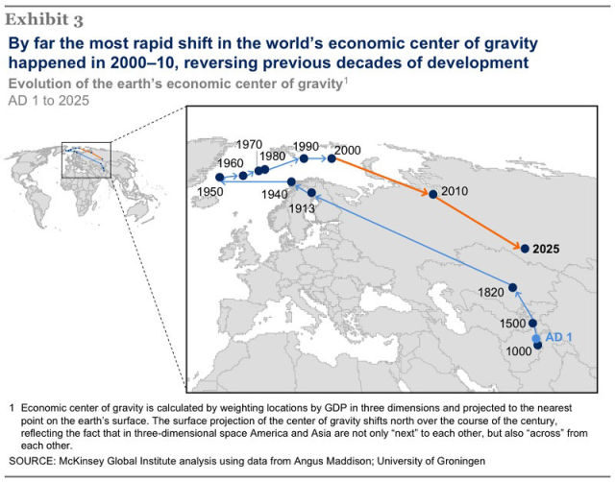
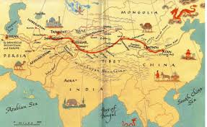
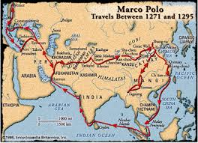
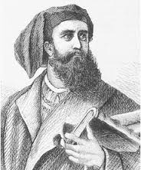
SHIFTING SANDS

Slide 4
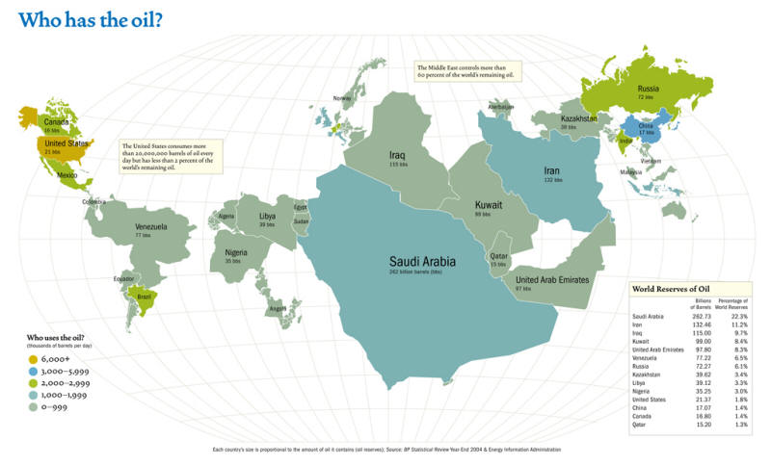
SHIFTING SANDS

Slide 5
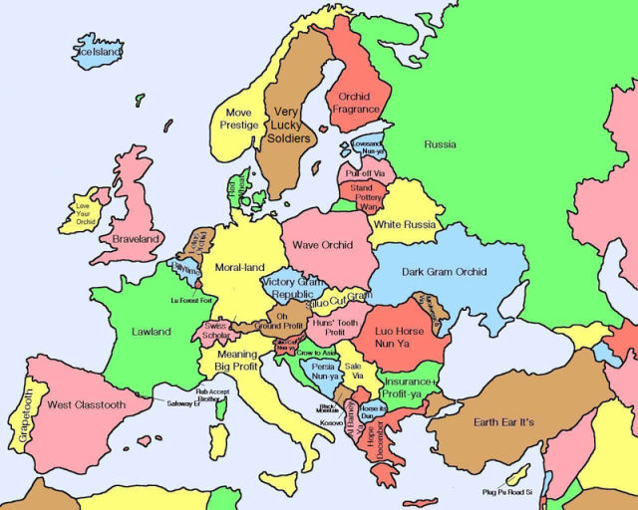
CHINA’S VIEW OF THE WORLD?

Slide 6
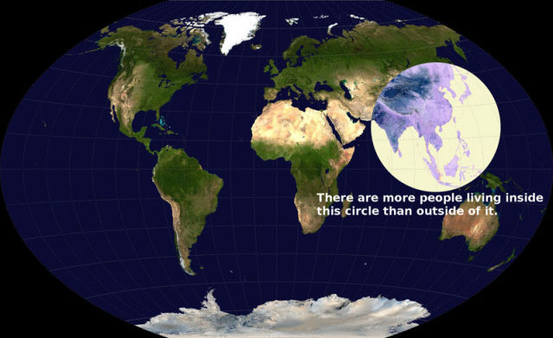
Our region

Slide 8
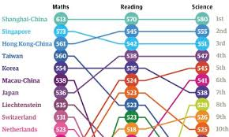
LITERACY IN OUR REGION
PRC
SINGAPORE
TAIWAN
KOREA
JAPAN
CAMBODIA
LAOS
INDONESIA
MYANMAR
PHILLIPINES
THAILAND
VIETNAM
SHANGHAI
HONG KONG
MACAU

Slide 10
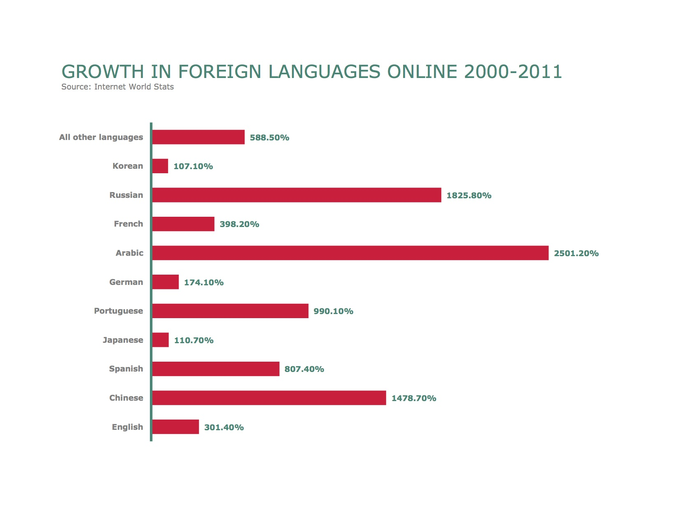

Slide 11
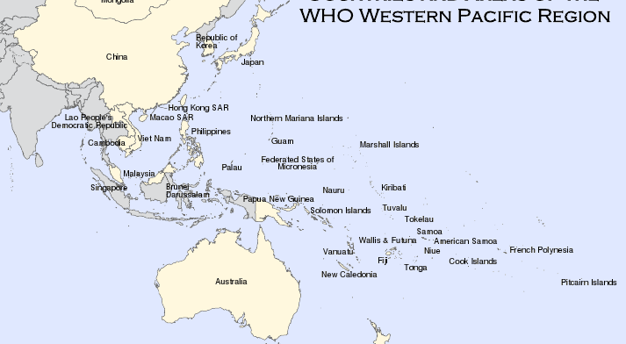
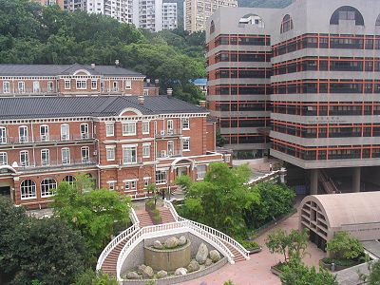
1.8 billion people (25%)

Slide 12
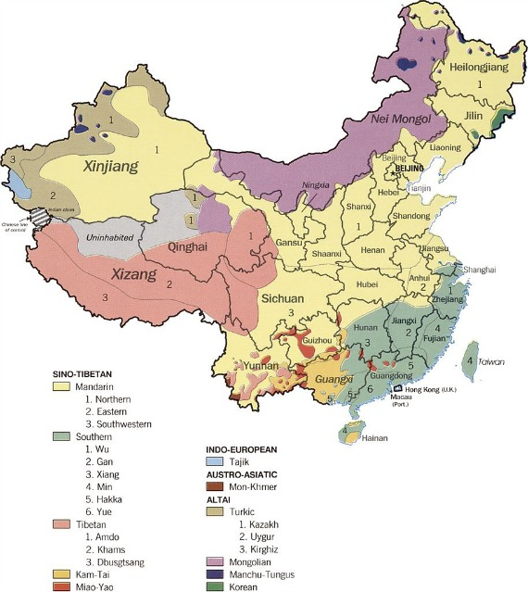

Slide 13
MULTILINGUAL REGION
RECOGNISED
NOT RECOGNISED
HONG KONG (2 -> 3)
INDIA (20+)
MALAYSIA (2)
SINGAPORE (4)
AUSTRALIA
JAPAN
CAMBODIA
KOREA
PHILLIPINES
ROC
THAILAND
VIETNAM
PRC

Slide 14
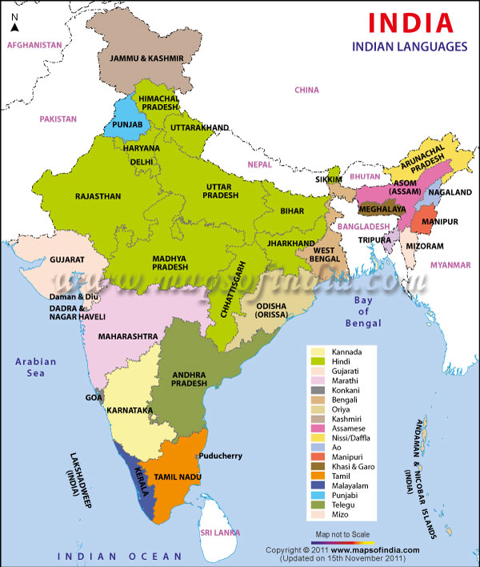

Slide 15
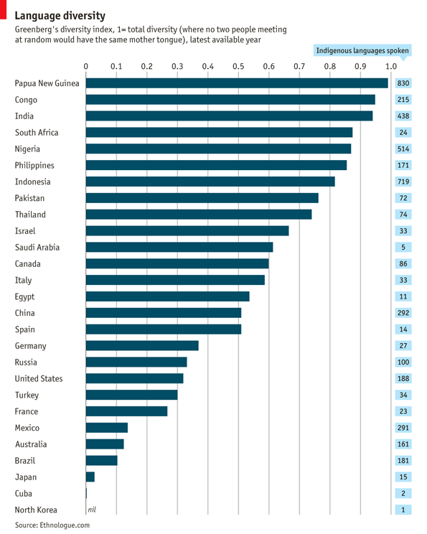

Slide 16
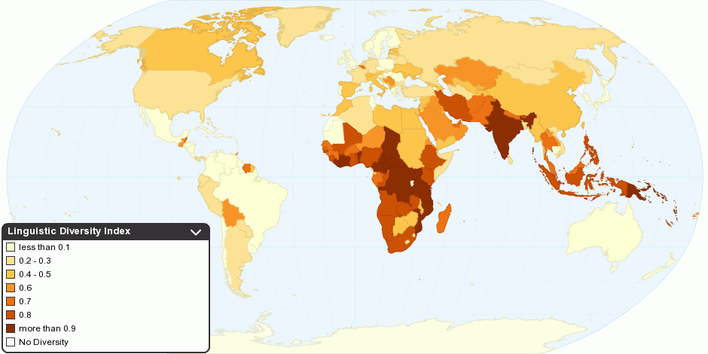

Slide 17
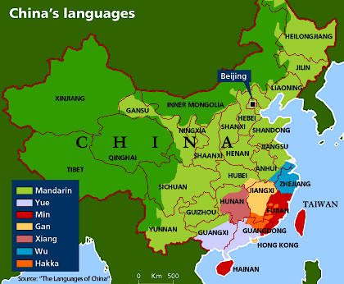

Slide 18
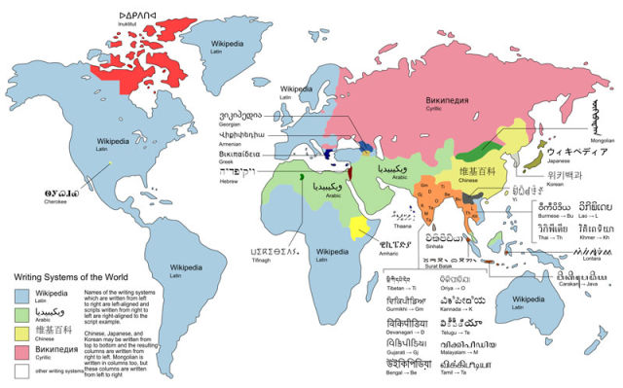
WRITING SYSYEMS

Slide 19
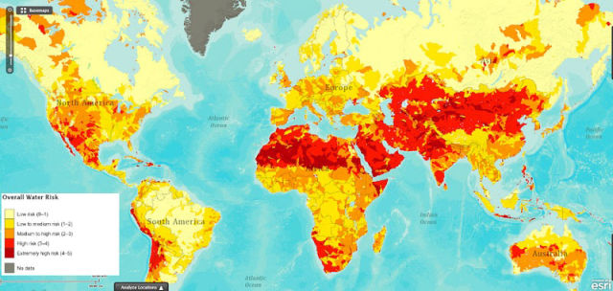
SHIFTING SANDS

Slide 20
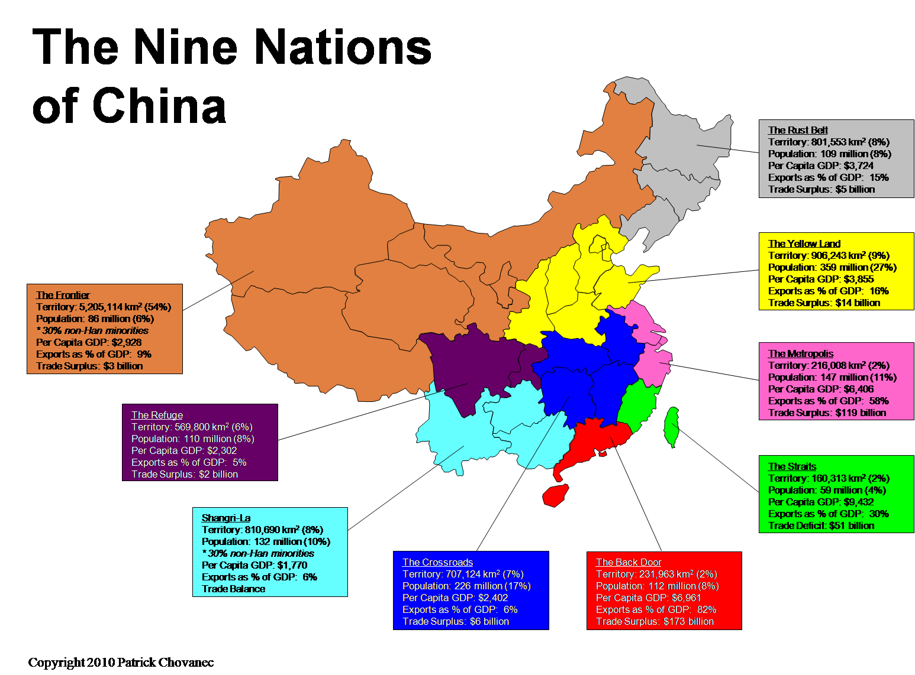

Slide 21
Summary
Geographic position makes us unique.
Multilingualism internationally relevant.
Our region internationally competitive.

Slide 22
Neuroscience of bilingualism
Abutalebi, J., Guidi, L., Borsa, V., Canini, M., Della Rosa, P.A., Parris, B., & Weekes, B.S. (2015). Bilingualism provides a neural reserve for aging populations. Neuropsychologia, (IF=4.2).
Abutalebi, J., Canini, M., Della Rosa, P.A., Green, D.W. & Weekes (2014a). The neuroprotective effects of bilingualism upon the inferior parietal lobule: A structural neuroimaging study in aging Chinese bilinguals. Journal of Neurolinguistics doi:10.1016/j.jneuroling.2014.09.008 (IF=1.97).
Abutalebi, J., Canini, M., Della Rosa, P.A., Sheung, L-P., Green, D.W. & Weekes, B.S. (2014b). Bilingualism protects anterior temporal lobe integrity in aging. Neurobiology of Aging. (IF=5.8).
Abutalebi, J., Della Rosa, P.A., Ding, G.S., Weekes, B.S., Costa, A., & Green, D.W. (2012). Language proficiency modulates the engagement of cognitive control areas in multilinguals. Cortex. doi: 10.1016/j.cortex.2012.08.018. (IF=6.1).
Della Rosa, P.A., Videsott, G., Borsa, V.M., Canini, M., Weekes, B.S., Franceschini, R., & Abutalebi, J. (2013). A neural interactive location for multilingual talent. Cortex. doi: 10.1016/j.cortex.2012.12.001. (IF=6.1).
Druks, J. & Weekes, B.S. (2014). Parallel deterioration to language processing in a bilingual speaker. Cognitive Neuropsychology, Special Issue: 50th Anniversary of the Academy of Aphasia, 30(7-8), 578-596. (IF=3.1).
Kambanaros, M., & Weekes, B.S. (2013). Phonological dysgraphia in bilingual aphasia: Evidence from a case study of Greek and English. Aphasiology, 27(1), 59-79. (IF=1.6).
Kong, A., Abutalebi, A., Lam, K., & Weekes, B.S. (2014). Executive and language control in the multilingual brain. Behavioural Neurology 10.3233/BEN-120331 (IF=1.7).

Slide 23
Cognition and Language
Bahktiar, M. & Weekes, B.S. (2014). Lexico-semantic effects on word naming in Persian: Does age of acquisition have an effect? Memory and Cognition, 1-16. (IF=2.0).
Bakhtiar, M., Nilipour, R., & Weekes, B.S. (2012). Predictors of timed picture naming in Persian. Behaviour Research Methods. doi:10.3758/s13428-012-0298-6. (IF=2.1).
Citron, F.F.M., Gray, M., Critchley, H.K., Weekes, B.S., & Ferstl, E.C. (2014). Emotional valence and arousal affect reading in an interactive way: Neuroimaging evidence for an approach-withdrawal framework. Neuropsychologia, 56, 79-89. (IF=4.5).
Citron, F.M.M., Weekes, B.S. & Ferstl, E.C. (2014). Arousal and emotional valence affect written word recognition in an interactive way. Language, Cognition and Neuroscience, 1-11. (IF=1.9).
Citron, F.M.M., Weekes, B.S. & Ferstl, E.C. (2014). How are affective word ratings related to lexico-semantic properties? Evidence from the Sussex Affective Word List (SAWL). Applied Psycholinguistics, 35, 313-331. doi: 10.1017/S0142716412000409 SAWL NORMS.
Citron, F.F.M., Weekes, B.S., & Ferstl, E.C. (2012). Effects of valence and arousal on written word recognition: Time course and ERP correlates. Neuroscience Letters, 533, 90-95. (IF=2.1).
Ulicheva, A., Coltheart, M. Saunders, S., Perry, C. & Weekes, B.S. (submitted) Phonotactic constraints: Implications for models of oral reading in Russian.
Ulicheva, A., Coltheart, M., Pritchard, S. & Weekes, B. (submitted). Nonword reading in Russian: Empirical and computational investigation.
Wang, L. & Weekes, B.S. (2014). Neural correlates of the Simon effect modulated by practice with spatial mapping. Neuropsychologia, 63, 72-84. (IF=4.5).

Slide 24
Translation
Abutalebi, J. & Weekes, B.S. (2014). The Cognitive Neurology of Bilingualism in the Age of Globalisation. IOS Press, Amsterdam.
Fletcher, P., Weekes, B.S., & Whitehill, T. (2013). Problem Based Learning (PBL) in audiology, language and speech pathology. Clinical Phonetics and Linguistics DOI:10.3109/02699206.2013.826285 (IF=0.78)
Law, S.P., Weekes, B.S., & Wong, A.M.Y. (Eds). (2009). Language Disorders in Speakers of Chinese. Bristol, UK: Multilingual Matters.
Law, S.P., Leung, M.T., Fung, R., Lui, H.M., & Weekes, B.S. (2012). A model of writing Chinese characters: Data from acquired dysgraphia and writing development. In E. Grigorenko, E. Mambrino, & D. Preiss (Eds.), Handbook of Writing: A Mosaic of Perspectives and Views. Hove, UK: Psychology Press.
Su, I.F., Klingebiel, K., & Weekes, B.S. (2010). Dyslexia and dysgraphia in Chinese: A cognitive neuropsychological approach. In N. Brunswick (Ed). The Role of Orthographies in Reading and Spelling. Hove, UK: Psychology Press.
Weekes, B.S. (2005). Acquired Dyslexia and Dysgraphia Across Scripts: I. IOS press, Amsterdam.
Weekes, B.S. (2010). Issues in Bilingual Aphasia. Hove: Psychology Press.
Weekes, B.S. (2012). Acquired Dyslexia and Dysgraphia Across Scripts: II. IOS press, Amsterdam.
Weekes, B.S., Su, I-F., To, K-S., & Ulicheva, A. (2013). Acquired dyslexia in bilingual speakers: Implications for models of oral reading. In D. Martin (Ed). Multilingual Literacies and Dyslexia. Bristol, UK: Multilingual Matters.
Wilson, M.A. Kahlaoui, K., & Weekes, B.S. (2012). Acquired dyslexia and dysgraphia in bilinguals across alphabetical and non-alphabetical scripts. In M. Gitterman, & L. Obler (Eds). Multilingual Aphasia. Bristol, UK: Multilingual Matters.

